Slide 1
Utah County Data Science
Wifi: Jane-guest
Pw: beourguest
Slack-
Signup at utahdata.herokuapp.com
Github: https://github.com/Utah-Data-Science/Utah-Data-Science.github.io
Many thanks to Jane for sponsoring the event.
Jane.com is an online marketplace for boutique deals
Check Jane’s open positions at jane.com/careers
(sorry no data positions at the moment)

Slide 2
Data Manipulation
Becoming a data wizard …
that does data magic …
with dplyr spells …
I’m a level 4 data bard.

Slide 3
Overview
Quick briefing on what encompasses data manipulation
Brief discussion on it’s importance
20 minute tangent on how Trump resembles a grown up Joffrey
Commands
Examples
Mic Drop

Slide 4
Data manipulation
Where you spend all your time
Where you could spend less of your time
Gateway to insights – can’t learn from data until its in a workable form

Slide 5
But what about awesome modeling?
Models are so cool and awesome and interesting...
That’s why this meetup has far fewer attendees…
That or people were expecting the usual Seth presentation

Slide 6
Everyone knows RUN DMC
Returns
Unequivocally
Nonstop
Diminish
with
Model
Complexity

Slide 7
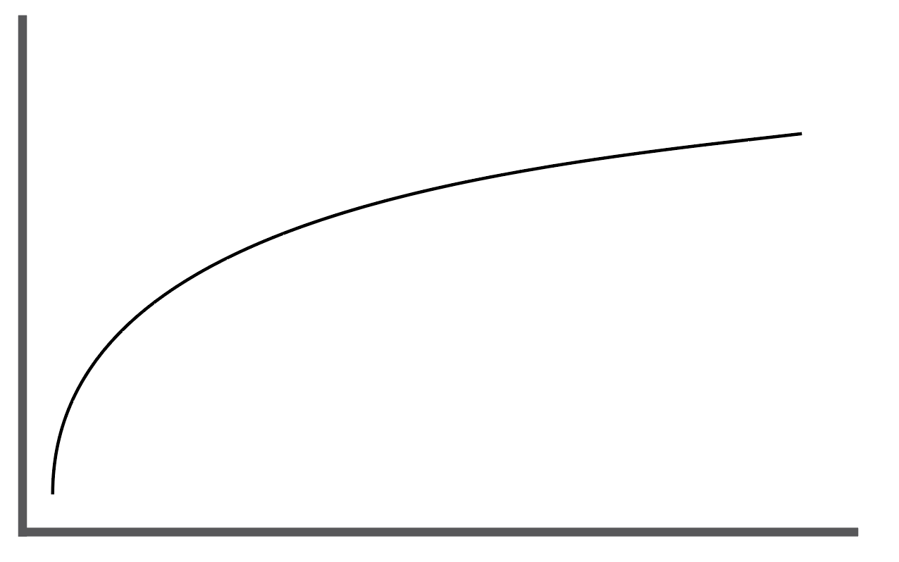
RUN DMC
XGBoost
Adaboosted
XGBoost determined weights
on ensemble of neural networks
Each with 20 layers
Two layers that have ReLU activation
The latter layers using a reduced feedback and dropout
With some random variance for good measure
Awesomness
Ensembles
Regression
Rule Based
Mostly..
Average Value
Model complexity
Sidenote: checkout github.com/bayandin/awesome-awesomeness

Slide 8
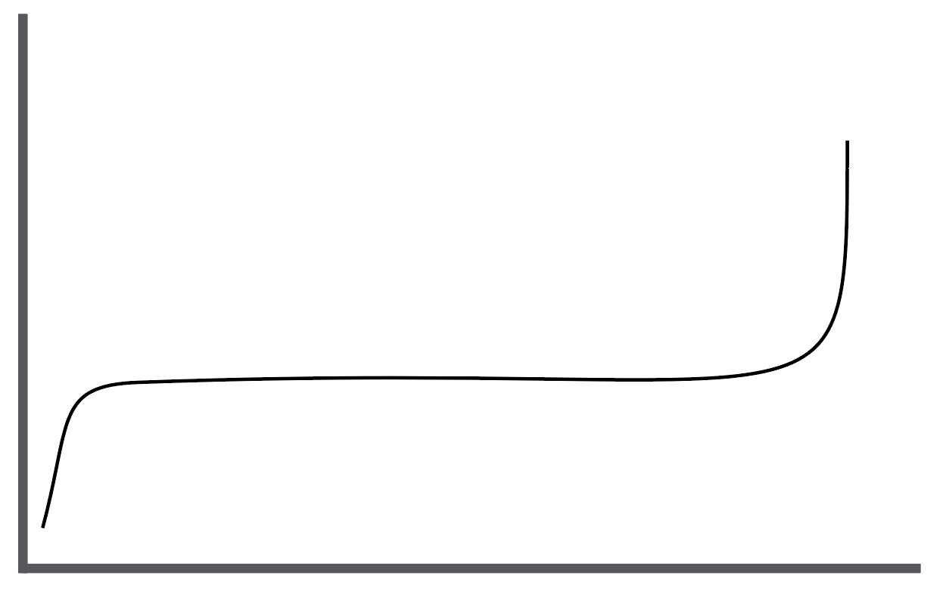
Images and such
Awesomness
Adaboosted
XGBoost determined weights
on ensemble of neural networks
Each with 20 layers
Two layers that have ReLU activation
The latter layers using a reduced feedback and dropout
With some random variance for good measure
XGBoost
Ensembles
Regression
Average Value
Rule Based
Model complexity
Sidenote: checkout github.com/bayandin/awesome-awesomeness

Slide 9
So?
More beats, more complex models
More data often means more weirdness in data
More data often means more sources

Slide 10
We need great tools to get that messy data of multiple sources into insight-able, machine learn-able form.

Slide 11
Data manipulation parts
Parsing
Merging/joining
Filtering/cleaning
Column operations (new variables from existing)
Aggregation/Windowing
Reshaping (the true wizardry)

